Slide 1
Amazon Sales Data Analysis
Amazon is one of the leading E-commerce platform where users can buy millions of products from a lot of categories.

Slide 2
Objectives
To calculate total sales, total profit, average profit margin and average unit price
• To find which order priority gave highest sales
• To find which is the bestseller Item type
• To find which mode of channel generated maximum sales • To find yearly total sales

Slide 3
The Process
Data Collection
Data Cleaning
Data Analysis
Insights
Summary

Slide 4
Data Collection
The Data has been collected in the form of a CSV file named “Amazon Sales Data.csv”.
The CSV file has the data of sales of products during the timespan of 2010 and 2017.

Slide 5
Data Cleaning
There were no Null values or blank fields Some values in ‘Order Date’ and ‘Ship Date’ columns are in String datatype. So we converted them to datetime datatype using Python
Most of the values in ‘Total Revenue’, ‘Total Cost’ and ‘Total Profit’ columns are written with two decimal places, so we make sure that each value in these columns have two decimal places by using Excel

Slide 6
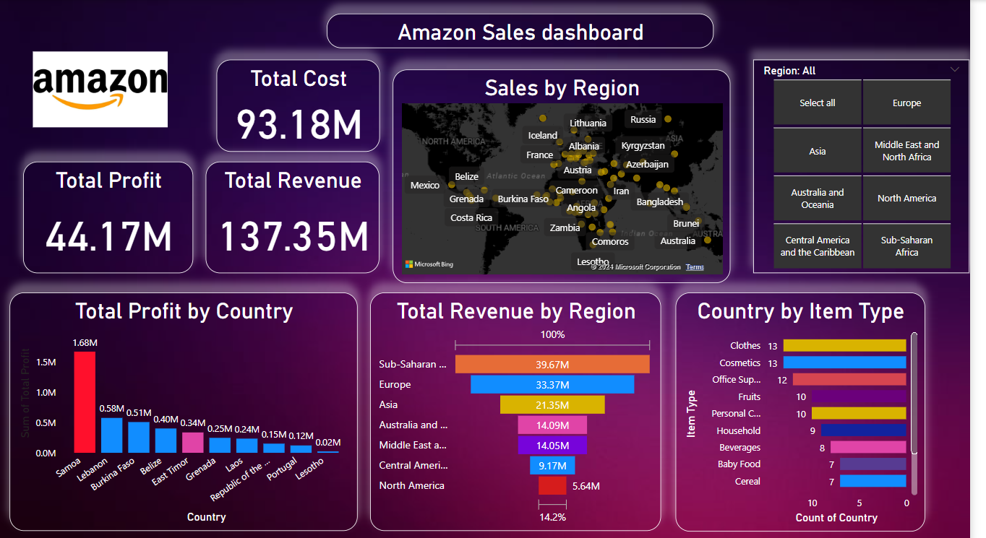
My Design

Slide 7
Thank you

